Slide 1
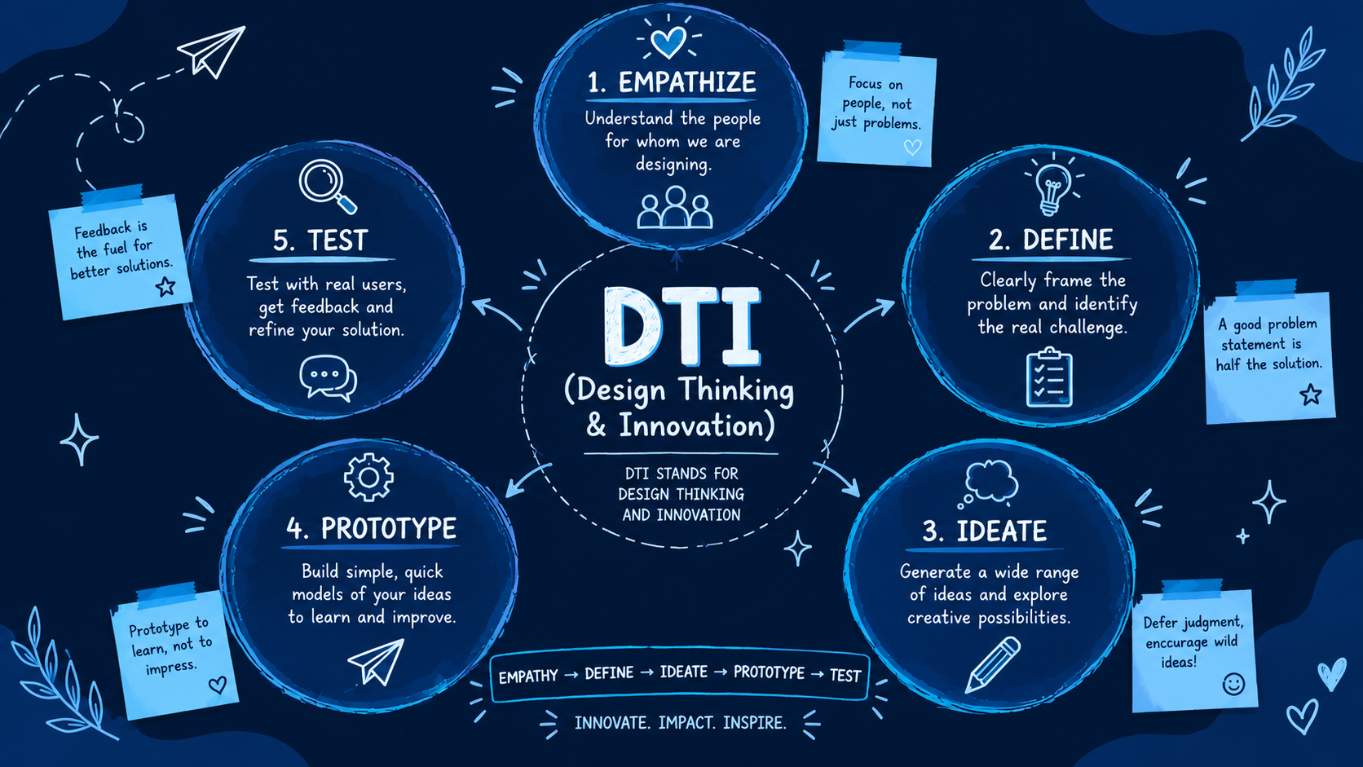

Slide 2

NUMBER OF PROBLEMS
Road Accidents And Delayed Response
Delayed emergency assistance and unsafe riding conditions can increase the severity of two-wheeler accidents.
2. Memory Gap Medicine Gap
Patients struggle to maintain complex, multi-dose medication routines, leading to missed doses, worsening health outcomes, and increased healthcare costs.
.
3. Losing Items Inside The Campus
Students often loses their important items inside the campus i.e. in libraries, lecture halls, mess, canteens, etc.
4. Improper Waste Management
Improper waste segregation and overflowing bins create hygiene and environmental problems.

Slide 3
PROBLEM AREA
1. Escalating Road Accident Vulnerability:
Riders face severe, unpredictable risks from poor road conditions, bad weather, and human errors.
2. Limitations of Passive Head Protection:
Traditional helmets only absorb initial impact shocks but fail to actively prevent complex brain injuries.
3. The 'Golden Hour' Response Gap:
Standard helmets lack crash detection, delaying emergency dispatch and turning survivable accidents into fatalities.
4. Absence of Behavioural Compliance Monitoring:
No built-in systems prevent high-risk actions like riding while intoxicated or leaving the helmet unbuckled.
5. Perceptual Blind Spots & Spatial Unawareness:
Regular helmets restrict peripheral sight and hearing, leaving riders blind to fast-approaching vehicles.

Slide 4
Problem Statement:
“When a two-wheeler accident occurs, traditional helmets only offer passive impact protection. They cannot detect a crash or call for help, leaving injured riders stranded during the critical 'Golden Hour' of survival and leading to preventable loss of life due to delayed emergency response."”

Slide 5
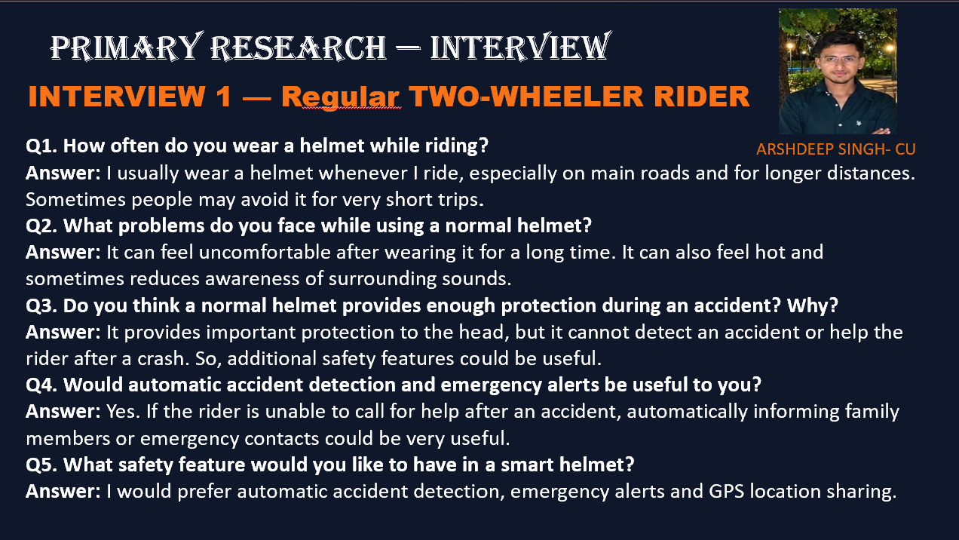

Slide 6

INTERVIEW 2 — COLLEGE STUDENT / YOUNG RIDER
YASH TYAGI
ACCIDENT SURVIVOR
Q1. What are the main safety risks you notice while riding a two-wheeler?
Answer: Traffic, sudden braking by other vehicles, poor road conditions and vehicles coming from behind or from the side are some common risks.
Q2. Have you ever faced difficulty noticing vehicles in your blind spot?
Answer: Yes, especially in heavy traffic. Sometimes a vehicle can approach from the side without being noticed immediately.
Q3. Do you think alcohol detection in a helmet could help prevent unsafe riding?
Answer: Yes. It could act as an additional safety measure by detecting alcohol before the rider starts or continues riding.
Q4. How useful would it be if the helmet automatically informed family members after an accident?
Answer: It would be very useful because family members could be informed quickly even when the rider cannot make a call themselves.

Slide 7
PRIMARY RESEARCH — SURVEY FORM
LINK-
https://forms.gle/zMrdHVcHeFuwygoZ6
1.Do you regularly travel on a two-wheeler?
2.How often do you wear a helmet while riding?
3.What is the main reason people may avoid wearing a helmet?
4.Do you think a conventional helmet provides enough safety during an accident?
5.How useful would automatic accident detection in a helmet be?
6.How useful would an automatic emergency alert to family/emergency contacts after an accident be?
7.Do you think blind-spot assistance could improve two-wheeler safety?
8.Which smart-helmet features would you find useful?
9.Would you consider using a smart helmet if it remained comfortable and affordable?
10.What is the most important improvement you would like to see in motorcycle helmets?

Slide 8
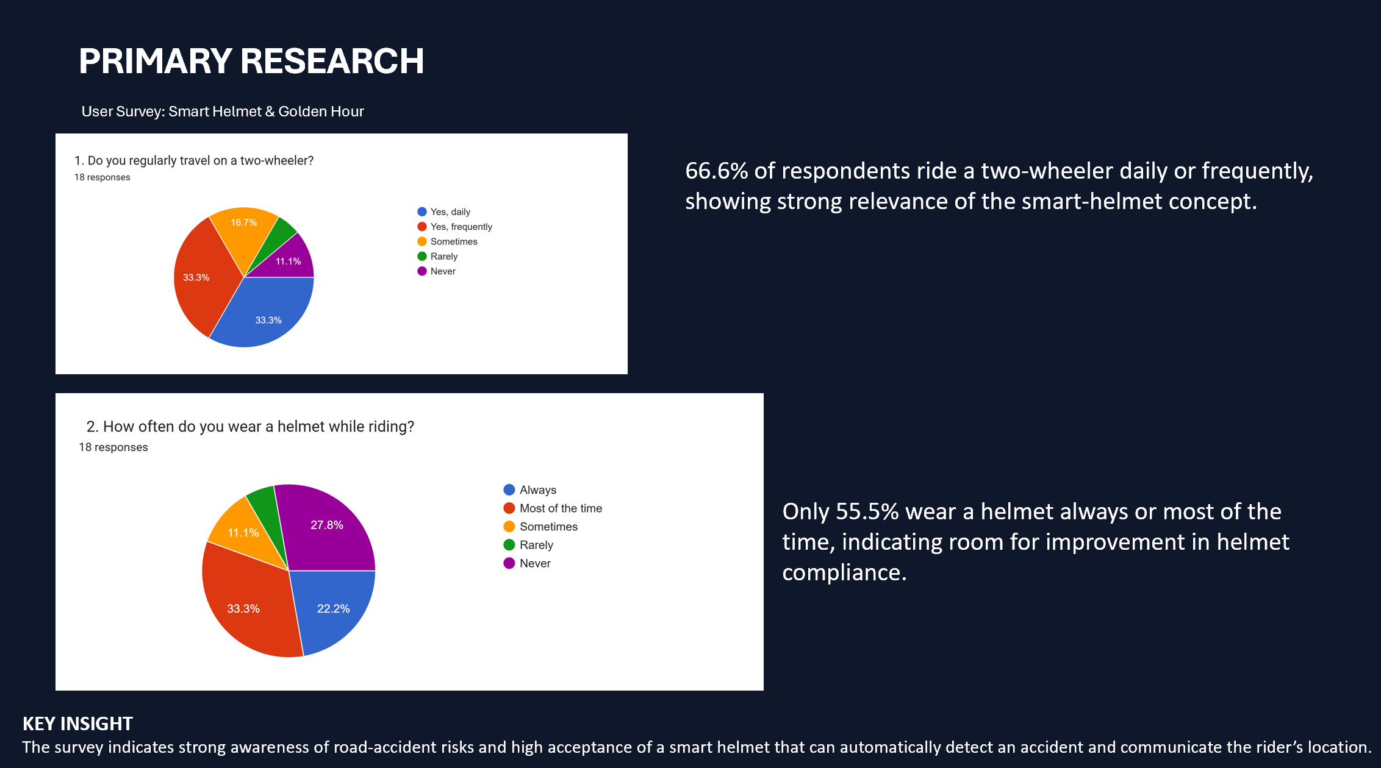

Slide 9

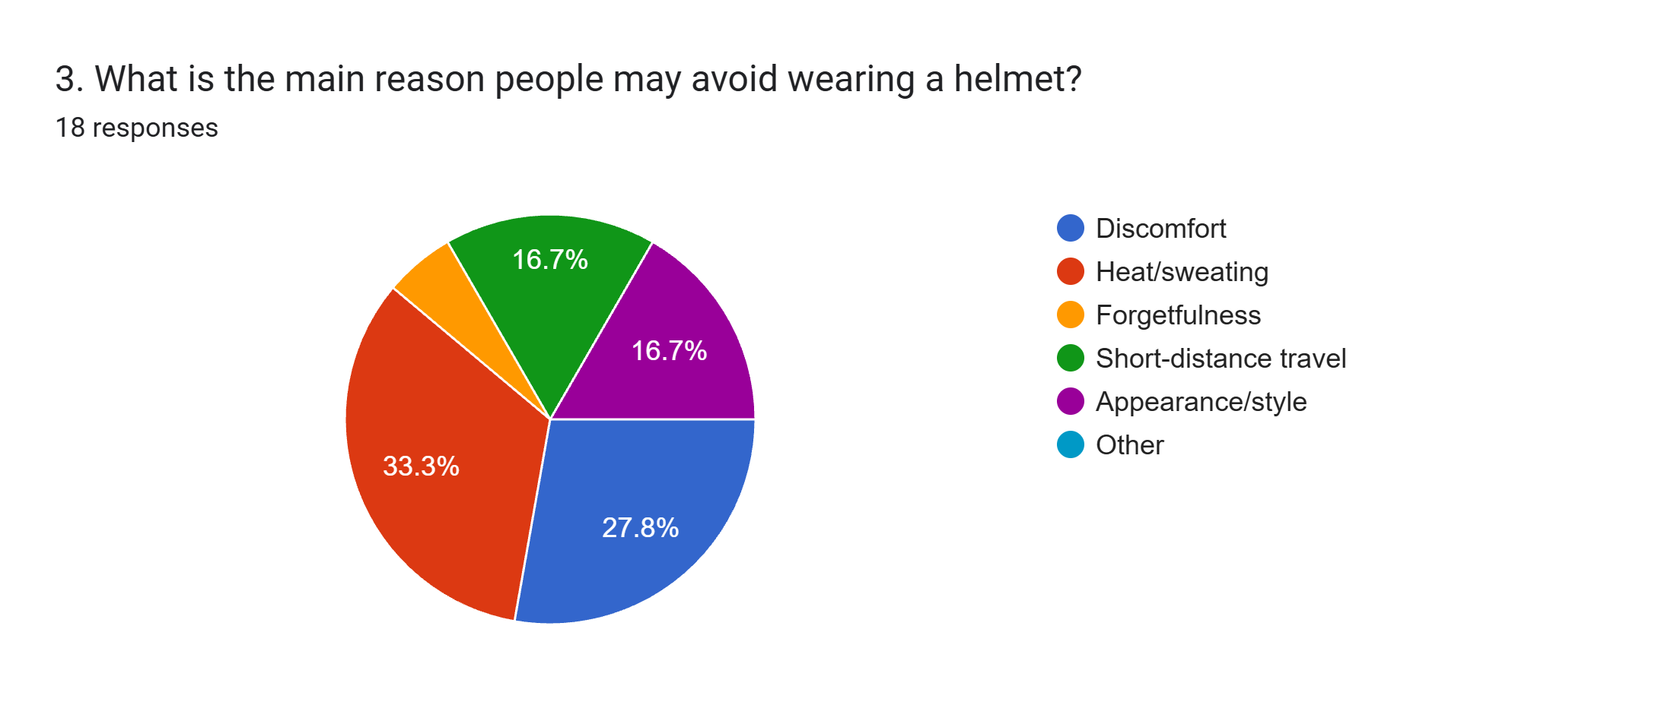
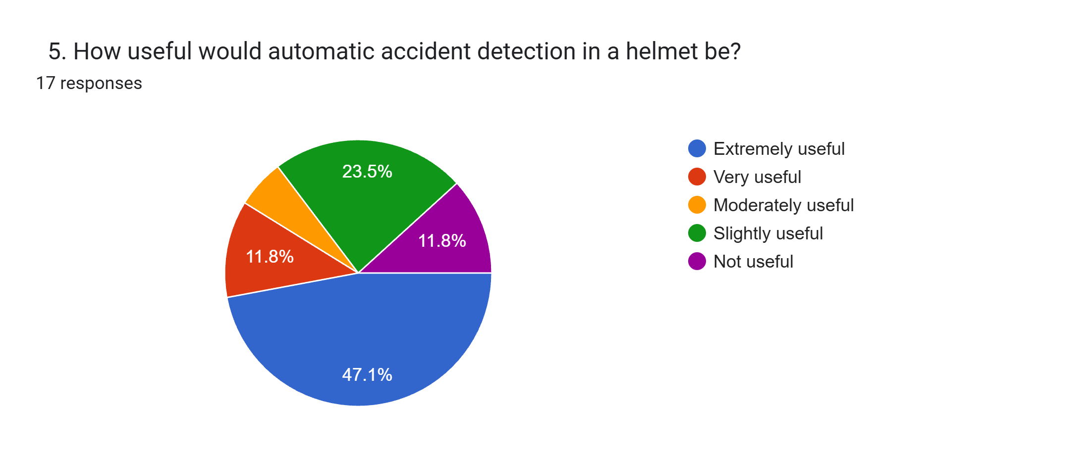
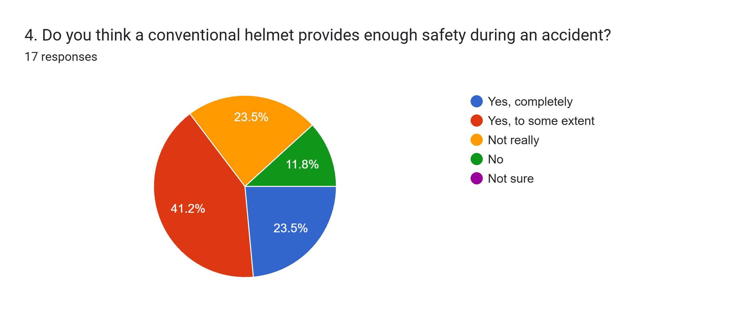
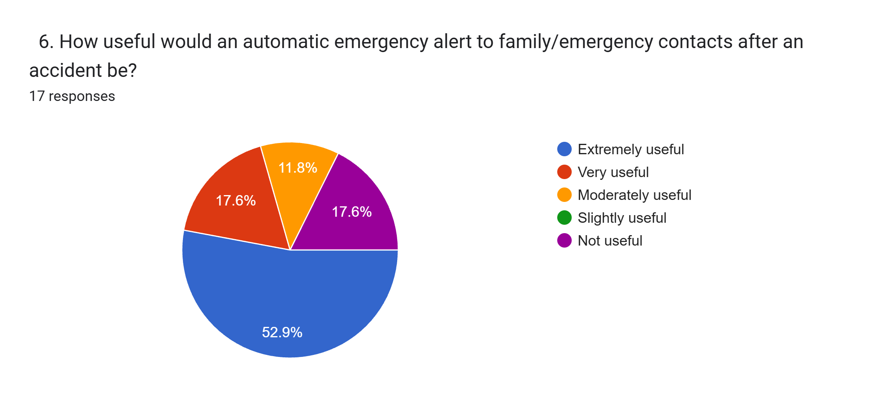
Heat/sweating is the biggest reason at 33.3%, followed by discomfort at 27.8%.
58.9% consider automatic accident detection extremely or very useful, showing strong demand for this feature.
64.7% feel conventional helmets provide complete or partial safety, while 35.3% remain unconvinced or unsure.
70.5% rate automatic emergency alerts as extremely or very useful, making it a highly valued safety feature.

Slide 10
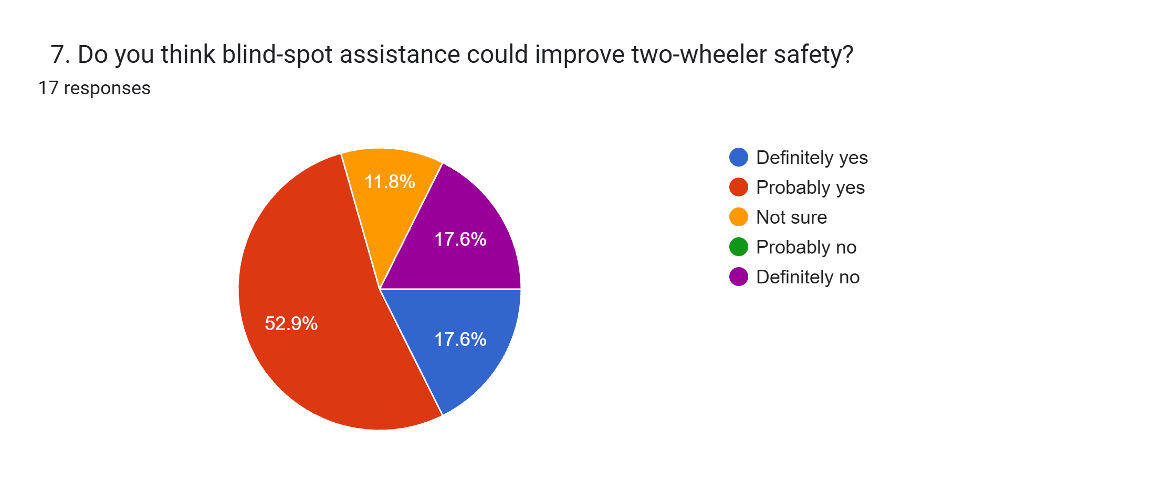
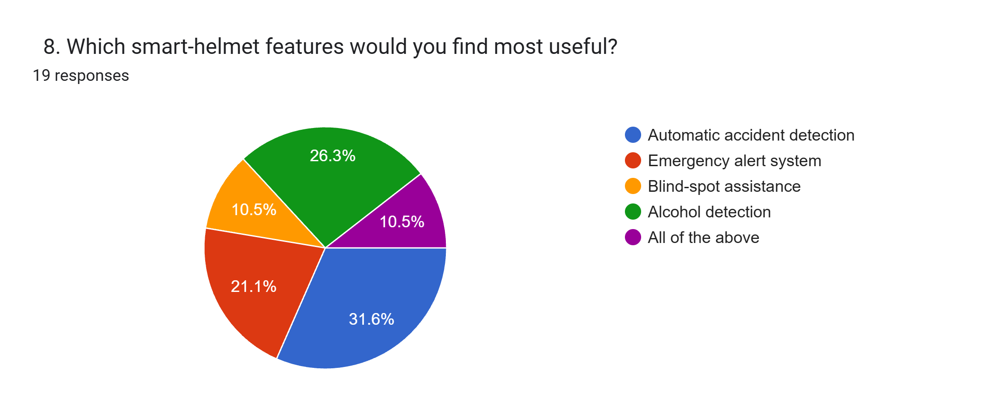
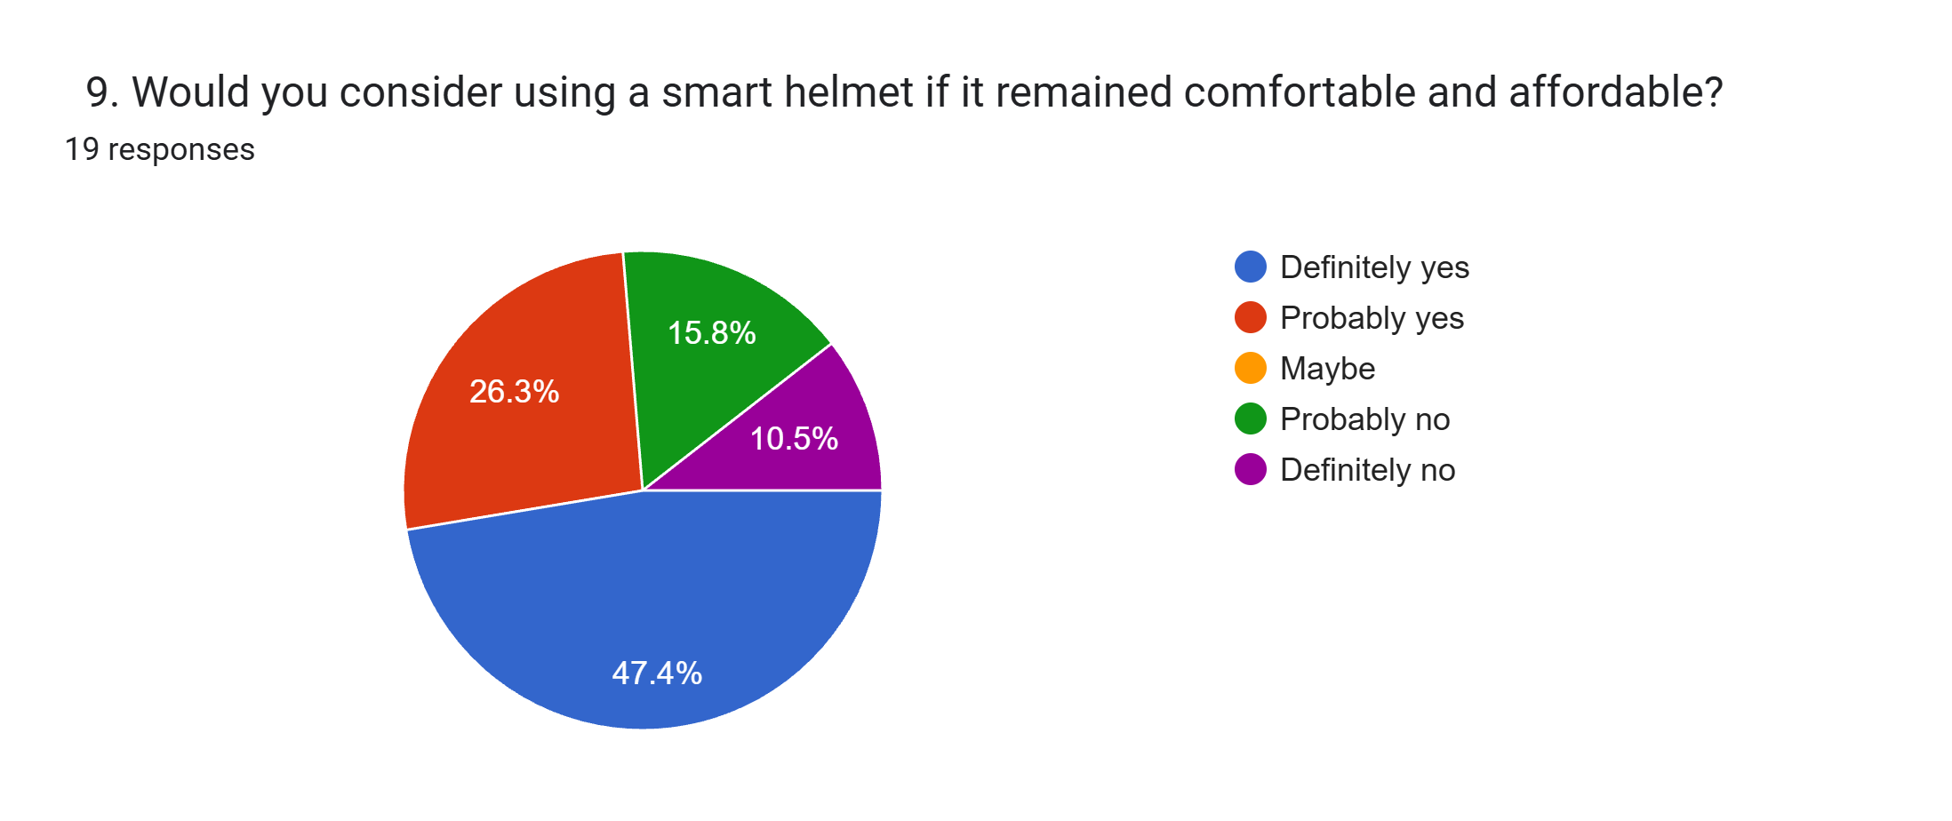
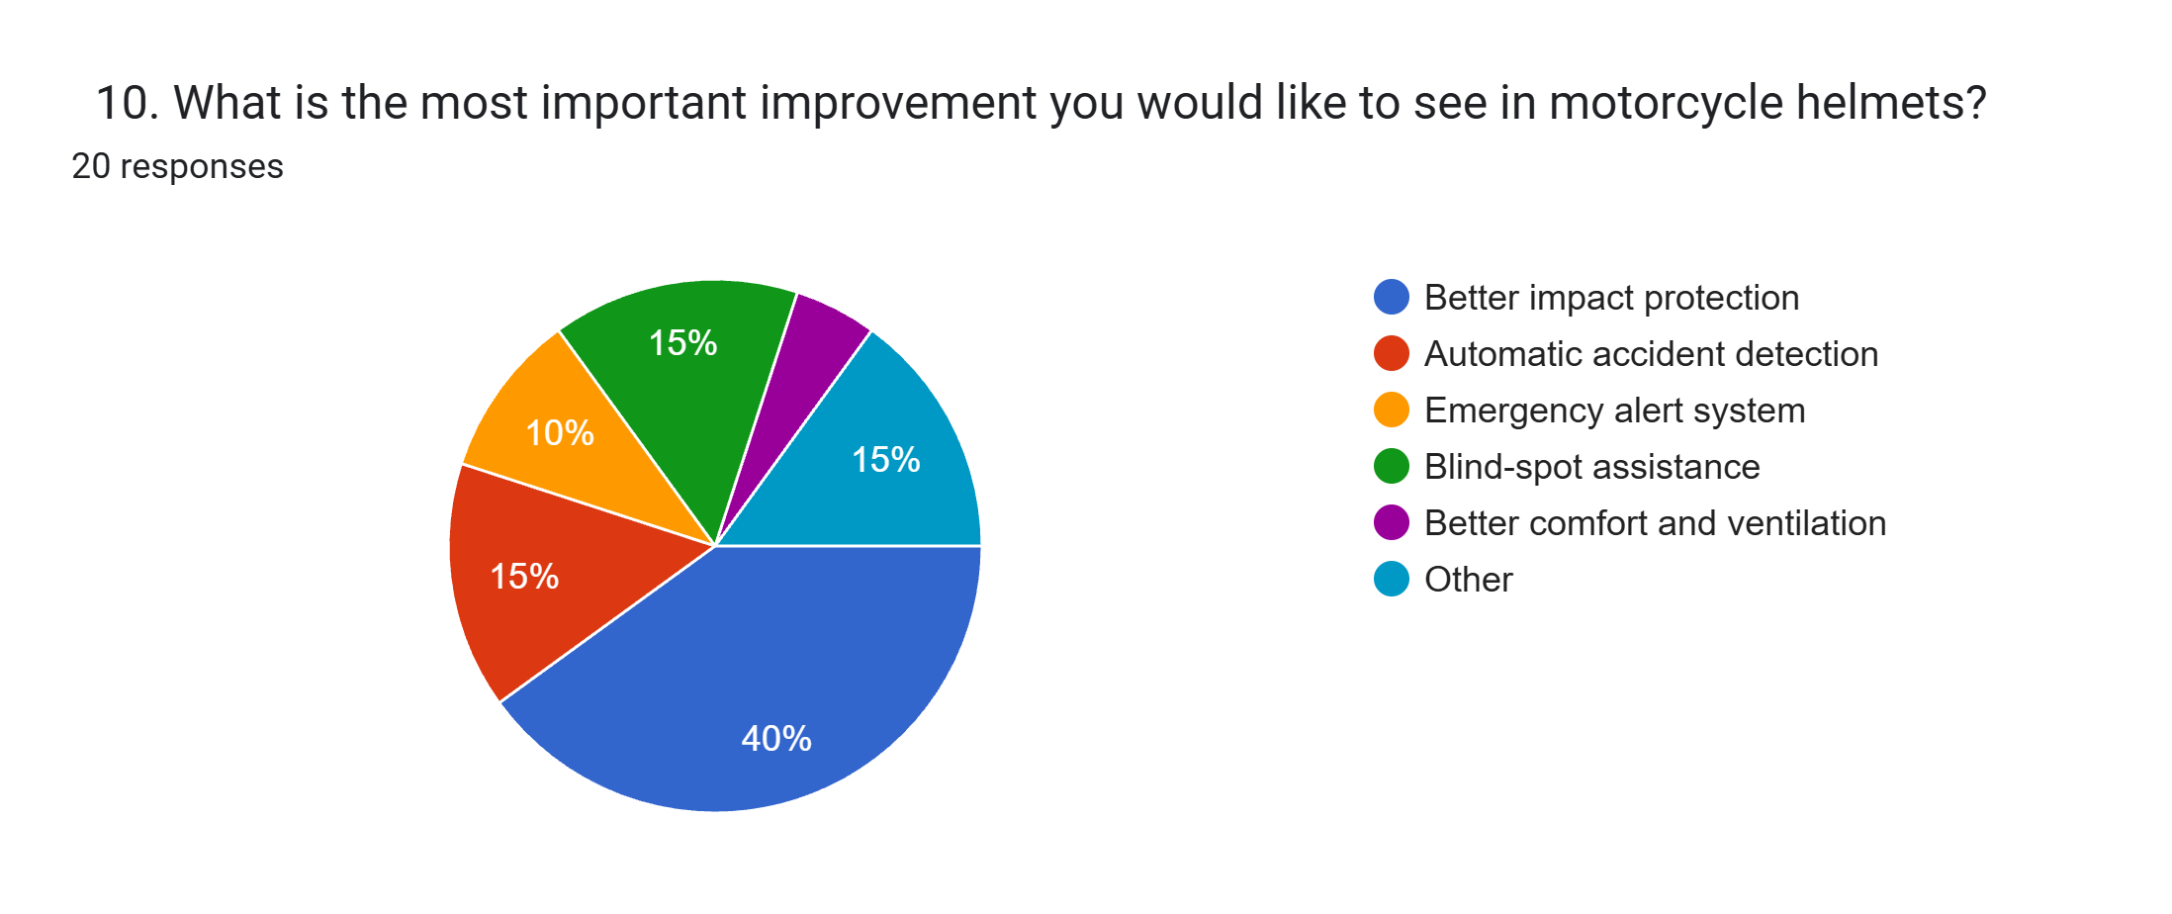
70.5% believe blind-spot assistance could definitely or probably improve two-wheeler safety.
Automatic accident detection received the highest preference at 31.6%, followed by alcohol detection at 26.3%.
73.7% would definitely or probably consider using a smart helmet if it remains comfortable and affordable.
40% selected better impact protection as the most important improvement, followed by automatic accident detection and blind-spot assistance at 15% each.

Slide 11
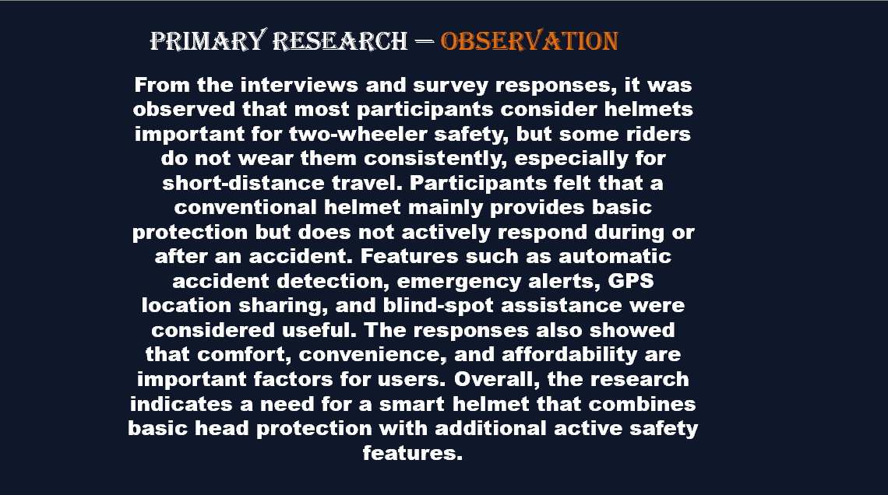

Slide 12
SECONDARY RESEARCH
AUTHOR(S) / YEAR | RESEARCH PAPER | MAIN IDEA | RELEVANCE TO OUR PROJECT
C. Santhanakrishnan, Divyansh Sharma & Adarsh Vashistha (2020) | Smart Helmet for Rider (SHR) and Accident Detection using IoT | Combines helmet detection, alcohol detection, vibration-based accident detection, GPS and GSM emergency messaging. | Shows how multiple safety functions can be integrated into a single helmet system and supports automatic accident-location sharing.
Cowsigan S. P., Sankari R., Sasi Kumar P. K., Nilaani K. & Chandra Prasad V. (2020) | Smart Helmet With GPS and GSM | Uses vibration and ultrasonic sensors with Raspberry Pi, GPS and GSM to detect accidents and send the rider’s location to emergency contacts. | Establishes the basic concept of automatic accident detection + GPS location sharing to reduce emergency-response time.
Md. Atiqur Rahman, Toufiq Ahmed, S. M. Ahsanuzzaman, Abid Ahsan & Ishman Rahman (2020) | IoT Based Smart Helmet and Accident Identification System | Uses IoT-based sensing to identify motorcycle accidents and support safety and emergency response. | Relevant to developing an IoT-enabled helmet capable of identifying accidents and communicating emergency information.
Mohammad Ehsanul Alim (2020) | Design & Implementation of IoT Based Smart Helmet for Road Accident Detection | Presents an IoT smart helmet concept for detecting road accidents and improving motorcycle-rider safety. | Supports the use of connected sensors and communication technology for faster accident response.
Bhavesh Shahare, Shivani Chawde, Rakesh Gudafwar, Harshada Pal & Purvi Bobade (2020) | IoT Based Smart Motorcycle Helmet | Integrates accident identification, GPS, GSM, alcohol detection, fall detection and helmet-use monitoring. | Demonstrates the potential for combining several active-safety features in one smart helmet.
Tanuja Bhende, Khushali Mahendra Thakur, Sejal Dhanraj Thakare, Vinay Ravindra Jambhulkar & Aditya Manoj Kale (2026) | Development of Smart Helmet for Accident Prevention Using IoT | Uses impact and alcohol sensors with GPS/GSM to detect accidents and send real-time alerts. | Directly supports the concept of automatic accident notification and location sharing for reducing response time.
Khawaja Moeez Ur Rahman, Khawaja Maaz Ur Rahman, Jannat Akbar, Rabeya Hamood, Ayaz Ur Rehman & Khawaja Hammad Ur Rahman (2025/26) | Battery-Efficient IoT-Enabled Smart Helmet for Real-Time Motorcycle Accident Detection and Notification | Focuses on a battery-efficient IoT smart helmet for real-time accident detection and immediate notification. | Relevant to creating a practical helmet that can continuously operate while maintaining rapid emergency notification.
A Low-Cost Smart Helmet with Accident Detection and Emergency Response for Bike Riders (2026) | Low-cost smart helmet using IMU, impact sensors and GPS-GSM | Reports 93.7% detection accuracy, 2.6% false-positive rate and 2.8-second mean emergency-alert latency in experimental testing. | Provides evidence that low-cost, standalone accident detection can support rapid emergency alerts and reduce avoidable response delays.

Slide 13
SECONDARY RESEARCH
INVENTOR(S) | PATENT | MAIN IDEA | RELEVANCE TO OUR PROJECT
Anirudha Surabhi Venkata Jaganadha Rao(2022) | US20220047028A1 – Integrated Smart Helmet and Methods and Systems of Controlling Smart Helmet | Detects impacts, determines whether the rider is involved in a crash and sends location-based notifications to emergency contacts. | Highly relevant to automatic crash detection + GPS location + emergency communication. (Google Patents)
Suk-Hoon Oh & Jeong-Il Choi (2020) | US20190357618A1 – Smart Helmet Fall Detection Method and Smart Helmet | Detects combinations of free fall, collision and motionlessness and generates an emergency signal when the conditions indicate a fall. | Relevant to confirming an actual accident before sending an emergency alert and reducing false alarms. (Google Patents)
Bo Zheng, Yongzheng Ye & Xiangling Yi2021 | US10897947B2 – Smart Helmet Fall Detection Method and Smart Helmet | Granted patent covering the smart-helmet fall-detection method using acceleration, collision and motionlessness detection. | Supports reliable accident/fall detection and emergency signalling when the rider may be unable to call for help. (Google Patents)
Anirudha Surabhi Venkata Jagannadha Rao2022 | US11406152B2 – Integrated Smart Helmet | Granted patent for an integrated smart helmet involving crash detection and helmet-control systems. | Relevant to integrating crash detection, location-based functions and emergency-response features into one helmet. (Google Patents)

Slide 14



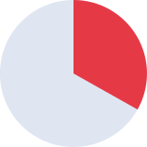


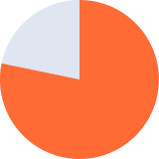



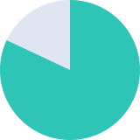
Empathy Map — Two-Wheeler Rider
💬 SAYS
💭 THINKS
SURVEY EVIDENCE
"A helmet protects my head, but it can't call for help."
"It should detect an accident automatically."
"Emergency alerts to family would be useful."
"Sharing my GPS location would help rescuers."
"Alcohol detection could stop drunk riding."
Who will call for help if I'm hurt alone?
I need more awareness of traffic around me
Helmets could offer more than protection
Extra features must stay comfortable
A smart helmet must remain affordable
33.3%
report heat / sweating
RIDER
🏍 DOES
❤ FEELS
Rides regularly for daily commuting
Wears a helmet as a routine habit
Watches surrounding vehicles closely
Relies on a conventional helmet
Occasionally skips the helmet
Worried about accidents
Vulnerable in heavy traffic
Anxious about blind spots
Uncomfortable from heat and sweat
Wants safety without losing comfort
73.5%
value emergency alerts
⚠ PAIN POINTS
✔ GAIN POINTS
Heat / sweating — 33.3%
Discomfort — 27.8%
Delayed emergency assistance
Difficulty seeing blind spots
No automatic accident detection
Inconsistent helmet use
Emergency alerts — 70.5%
Blind-spot assistance — 70.5%
Accident detection — 58.9%
GPS location sharing
Better impact protection — 40%
Comfortable, affordable helmet — 73.7% willing
70.7%
willing to use if comfortable

Slide 15



5 Why Analysis — Why Is a Conventional Helmet Not Enough?
PROBLEM: Riders can remain vulnerable even when wearing a conventional helmet.
WHY 1
Why are riders still vulnerable?
→ A conventional helmet only reduces head injury during impact.
WHY 5
Why can't it detect anything?
→ It is purely passive — no sensors, alerts, or GPS built in.
WHY 2
Why is impact protection not enough?
→ It can't prevent risks like blind spots or help after a crash.
WHY 4
Why is no one notified?
→ The helmet cannot detect an accident or share location.
WHY 3
Why does help come late?
→ No one is notified if the rider is injured or unconscious.
64.7%
70.5%
feel partially/completely safe
35.3%
70.5%
support blind-spot assistance
unsure about helmet safety
find emergency alerts useful
ROOT CAUSE
Traditional helmets provide only passive protection and lack active safety systems for accident detection, emergency alerts, and blind-spot awareness.

Slide 16


















SWOT ANALYSIS — TRADITIONAL HELMET
STRENGTHS
WEAKNESSES
Reliable basic head protection
Familiar and widely trusted
No electronics or charging needed
Simple, durable, low maintenance
Affordable and easy to access
Positive safety perception among riders
Passive protection only
No accident detection or alerts
No GPS location sharing
No blind-spot assistance
Heat build-up and sweating
Discomfort on longer rides
Limited ventilation
33.3%
Heat / sweating
64.7%
Feel conventional helmets provide complete or partial safety
27.8%
Discomfort
OPPORTUNITIES
THREATS
Better ventilation and airflow
Lighter, more comfortable fit
Stronger impact protection
Improved peripheral awareness
Emergency response features
Higher user acceptance & usage
Riders skip helmets due to heat
Discomfort lowers consistent use
Non-use on short-distance trips
Rising expectation of active features
Competition from smart helmet tech
Weak habits & enforcement gaps
55.5%
Helmet use frequency
40%
Chose better impact protection as the top improvement wanted
66.6%
Ride two-wheelers often

Slide 17
Ideation — Turning Insights into Ideas
HOW MIGHT WE… (one question per team member)
Detect a crash automatically and get help to the rider inside the “Golden Hour”?
SURVEY SIGNALS BEHIND OUR IDEAS
1
% of survey respondents
58.9% rate automatic accident detection very / extremely useful · 70.5% value emergency alerts
Make riders aware of vehicles in their blind spots without blocking sight or hearing?
2
70.5% say blind-spot assistance could improve safety
Discourage risky riding such as drunk riding or an unfastened helmet?
3
26.3% picked alcohol detection as a top feature · only 55.5% always / mostly wear a helmet
Add smart features while keeping the helmet cool and comfortable?
4
33.3% blame heat / sweating · 27.8% discomfort
GROUND RULES FOR BRAINSTORMING
Keep it affordable, long-lasting and strong on impact protection?
• Defer judgment — no bad ideas yet
• Quantity first: 8 ideas in 8 minutes
• Build on each other’s ideas
• Stay linked to rider evidence
5
73.7% would use one if affordable · 40% want better impact protection

Slide 18








































Crazy 8 — 5 Members × 8 Ideas in 8 Minutes
Each member folded a sheet into 8 panels and sketched one idea per minute, answering their own HMW. ★ = idea taken forward to selection.
1
MEMBER 1
2
MEMBER 2
3
MEMBER 3
4
MEMBER 4
5
MEMBER 5
Crash & Rescue
Awareness
Safe Riding
Cool & Comfort
Strong & Affordable
1
★
2
★
1
★
2
★
1
★
2
1
★
2
★
1
★
2
Impact-sensor trigger
Free-fall + stillness check
Rear ultrasonic radar
LED blind-spot light
Breath-alcohol sensor
Ignition lock if drunk
Vent channels
Moisture-wicking liner
Upgraded impact foam
Modular sensor pod
3
★
4
★
3
4
3
★
4
3
4
3
4
★
30-sec “I’m OK” cancel
GPS location in SOS
Side vibration warning
Tiny rear camera
Buckle-strap sensor
Helmet-worn check
Crown micro-fan
Ultra-light shell
Solar charge strip
Long-life battery
5
★
6
5
6
5
6
5
6
5
★
6
Auto-SMS to family
Ping nearest hospital
Bone-conduction alerts
Wide-angle visor
Match helmet to bike
Over-speed buzzer
Cooling gel pad
Washable liner
Low-power sleep mode
Works without phone
7
8
7
8
7
8
7
8
7
8
Crash “black box” log
Siren + beacon LED
Helmet turn signals
Approaching-car HUD
Weekly safety score
Family dashboard
Quick-fit dial
Anti-fog visor
Low-cost parts list
Retrofit kit

Slide 19
Idea Selection — Evidence Over Opinion
Every Crazy 8 idea was scored against our own survey data and the secondary research. The strongest ideas combine into one concept.
CONCEPT (FROM CRAZY 8) | SURVEY DEMAND | RESEARCH BACKING | FEASIBILITY | DECISION
Crash detection: impact + free-fall + stillness (M1) | 58.9% rate it very / extremely useful; top-picked feature at 31.6% | US20190357618A1 and US10897947B2 confirm a real fall and cut false alarms | High | BUILD NOW
Auto SOS: GPS + GSM alert with 30-sec cancel (M1) | 70.5% rate emergency alerts very / extremely useful | Cowsigan 2020; 2026 low-cost helmet reports 2.8 s alert latency | High | BUILD NOW
Blind-spot radar + LED / vibration warning (M2) | 70.5% say it could improve two-wheeler safety | Interview 2: vehicles from the side go unnoticed in heavy traffic | Medium | BUILD NOW
Breath-alcohol sensor with warning (M3) | 26.3% chose it as a top feature, second after crash detection | Shahare 2020 and Bhende 2026 both use alcohol sensors | High | BUILD NOW
Vent channels + moisture-wicking liner (M4) | Heat / sweating 33.3% and discomfort 27.8% are the top barriers | Reviewed papers focus on sensing; comfort is an open gap | Medium | BUILD NOW
Long-life battery + low-power sleep mode (M5) | 73.7% would use a smart helmet if comfortable and affordable | Rahman 2025/26: battery-efficient smart helmet | High | BUILD NOW
Upgraded impact foam / shell (M5) | 40% rank better impact protection as the top improvement | Needs safety-standard testing before any claim | Low | PHASE 2
Buckle-strap + helmet-worn sensor (M3) | Only 55.5% always / mostly wear a helmet | Shahare 2020 monitors helmet use | High | PHASE 2

Slide 20
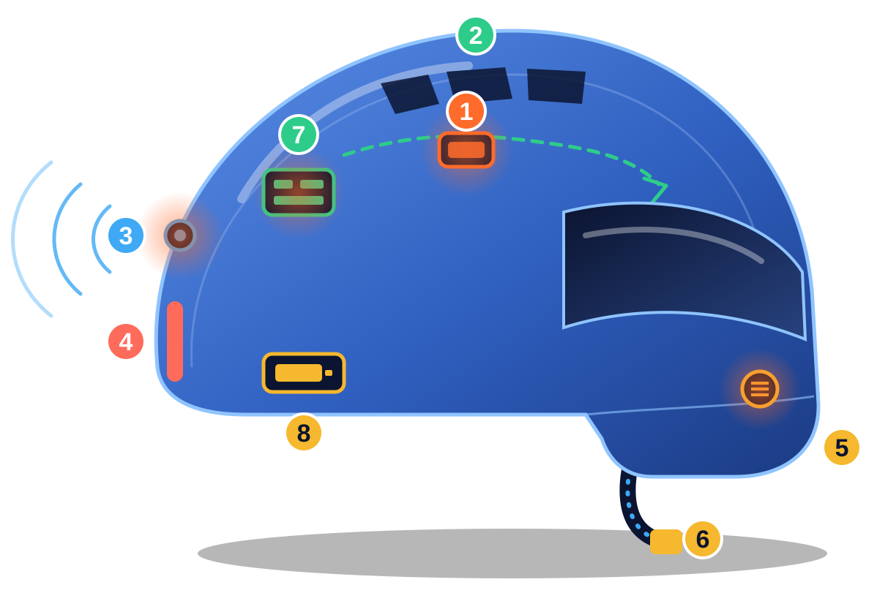
Prototype — SafeRide Smart Helmet
Selected concept: a comfortable helmet that detects a crash, calls for help, warns of blind spots and flags unsafe riding.
COMPONENTS
1
Impact + IMU sensor
Detects shock, free-fall and stillness
58.9% want crash detection
2
Ventilation channels
Airflow with a wicking liner
33.3% cite heat
3
Rear ultrasonic radar
Senses vehicles in blind spots
70.5% back blind-spot help
4
Rear warning LED
Makes rider visible, flashes after a crash
Interview 2: unseen side traffic
5
Breath-alcohol sensor
Warns before the ride starts
26.3% top-feature pick
6
Buckle-strap sensor
Confirms the helmet is fastened
55.5% wear one always / mostly
7
Control unit + GPS / GSM
Confirms crash, sends SOS with location
70.5% value emergency alerts
Active protection on top of a normal helmet: sense → confirm → alert → warn, with vents and a light liner to keep riders comfortable.
8
Battery pack
USB-C charging, low-power sleep mode
73.7% want it affordable

Slide 21


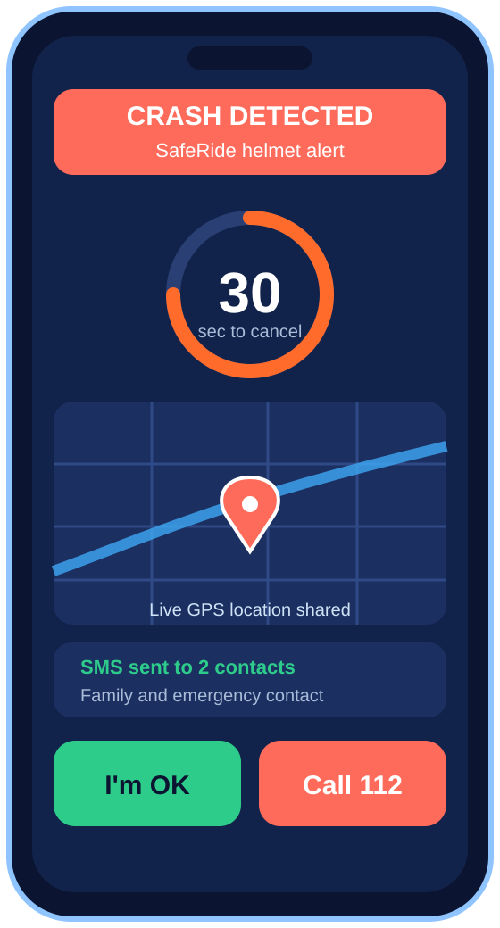
Prototype — How It Works and How We Will Test It
STEP 1
STEP 2
STEP 3
STEP 4
STEP 5
SENSE
CONFIRM
COUNT DOWN
ALERT
RESPOND
IMU and impact sensor read sudden shock, free-fall and tilt.
A crash counts only if impact is followed by stillness, which cuts false alarms (US20190357618A1).
Buzzer and app give 30 seconds to cancel with “I’m OK”.
GSM sends an SMS with a live GPS link to family and emergency contacts.
Siren and rear LED guide bystanders; one tap calls 112.
TEST TARGETS — benchmarked on the 2026 low-cost smart-helmet study from our secondary research
93.7%
≤ 2.6%
≤ 2.8 s
crash-detection accuracy to match
false-positive rate to stay under
crash-to-alert time to beat
NEXT: TEST WITH REAL USERS
1. Bench-test the sensors and the 30-second countdown with a simulated impact.
2. Trial the vents and liner on riders and compare heat / sweat against a conventional helmet.
3. Show the alert screen to family contacts, then feed what we learn back into the design.
Alert seen by the rider’s family

